Slide 1
TIME-BASED INDOOR PLANT IRRIGATION SYSTEM
&
RTC-Based Medicine Reminder & Assistance System for Elderly People
Using Atmega32 Microcontroller & RTC
Automatic Watering for Indoor Plants
Presented by: Minnu Prakash

Slide 2
RTC (DS3231)
↓ (Time)
ATmega328P
↓
Buzzer / Voice Module
↓
Elderly Person Alert
Button / Sensor (Medicine Taken)
↓
ATmega328P

Slide 3
ATmega328P
RTC Module (DS3231 recommended)
Buzzer (or voice module)
LED indicator
Push button (medicine taken confirmation)
Battery power

Slide 4
Introduction
Indoor plants require regular and controlled watering
Manual watering can lead to overwatering or neglect
Time-based irrigation automates watering at fixed intervals
Uses RTC to maintain accurate watering schedule
Objective
To design an automatic indoor plant irrigation system
To supply water at predefined time intervals
To reduce human effort and water wastage
To ensure healthy plant growth

Slide 5
System Concept
System works based on time scheduling
RTC keeps track of real-time clock
Atmega checks scheduled watering time
Pump is activated automatically via relay
Water is supplied through drip lines
Main Components
Water source (Tank / Bottle)
DC Pump -
Relay module - SRD-05VDC-SL-C
Atmega Microcontroller
RTC module
Pipes / Drip lines
Battery power supply

Slide 6
Water Source
Stores water required for irrigation
Small tank or bottle suitable for indoor use
Supplies water to the pump
DC Pump
Pushes water from tank to plants
Operates only during watering time
Low voltage DC pump used for safety
Relay Module
Acts as an electronic switch
Controls pump ON/OFF
Isolates STM32 from high-current load
Protects controller from motor damage

Slide 7
STM32 Microcontroller
Acts as the brain of the system
Reads current time from RTC
Compares time with watering schedule
Controls relay operation
Supports low power operation
RTC Module
Maintains accurate date and time
Works even when STM32 is powered OFF
Powered by coin cell battery
Ensures precise watering schedule

Slide 8
Pipes / Drip Lines
Carry water from pump to plant roots
Provide controlled water flow
Prevent water wastage and overflow
Power Supply
Battery-powered system
Supplies power to STM32, relay, and pump
Suitable for portable and indoor usage
Low power consumption design

Slide 9
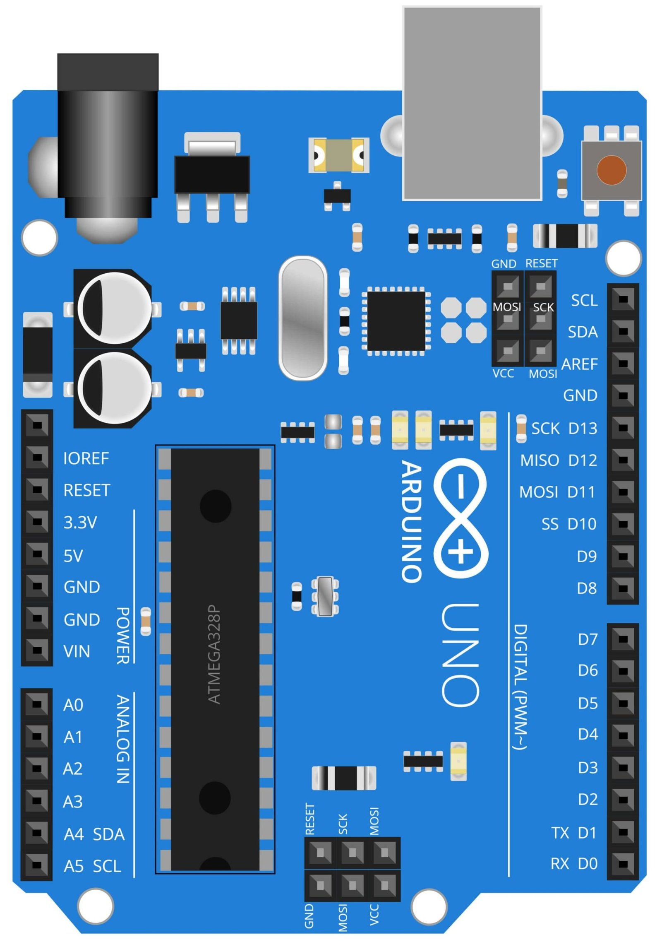
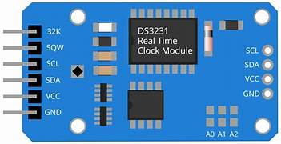
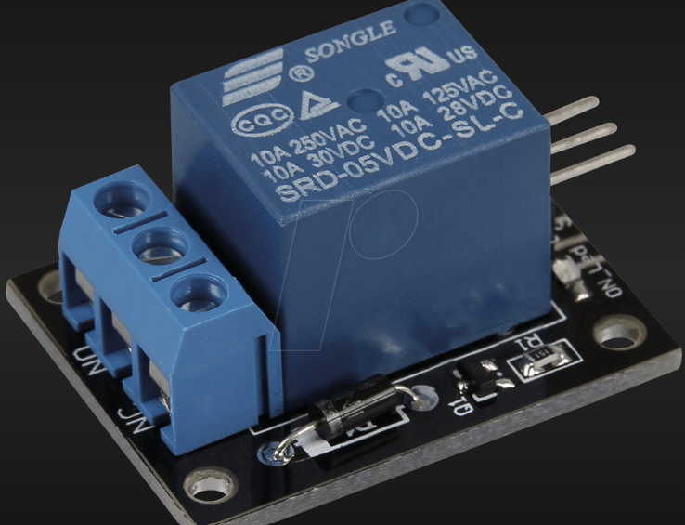
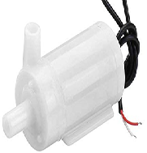
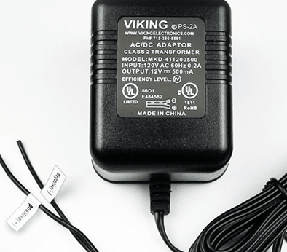

Slide 10
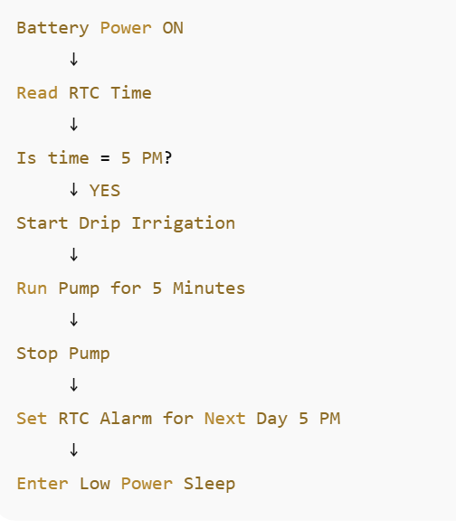
Indoor Drip Irrigation Using RTC

